Slide 1
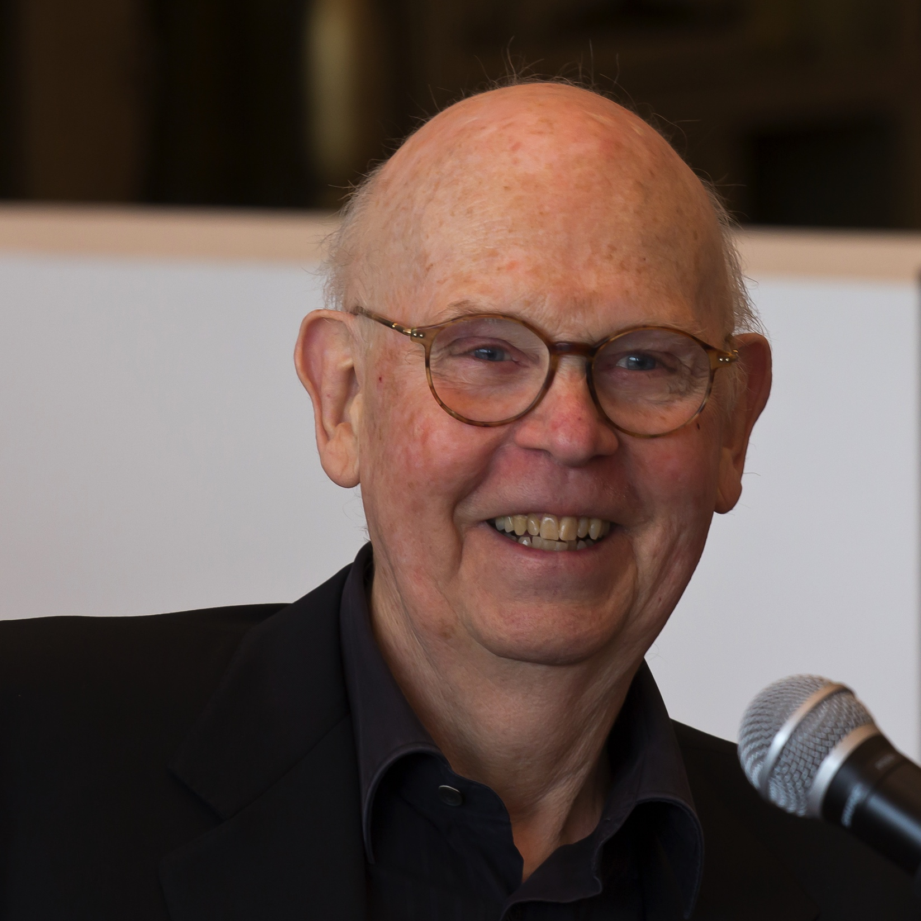
Claes Oldenburg
Born January 28, 1929
From Stockholm, Sweden
Pop Art Sculptor
Public Art Installations

Slide 2
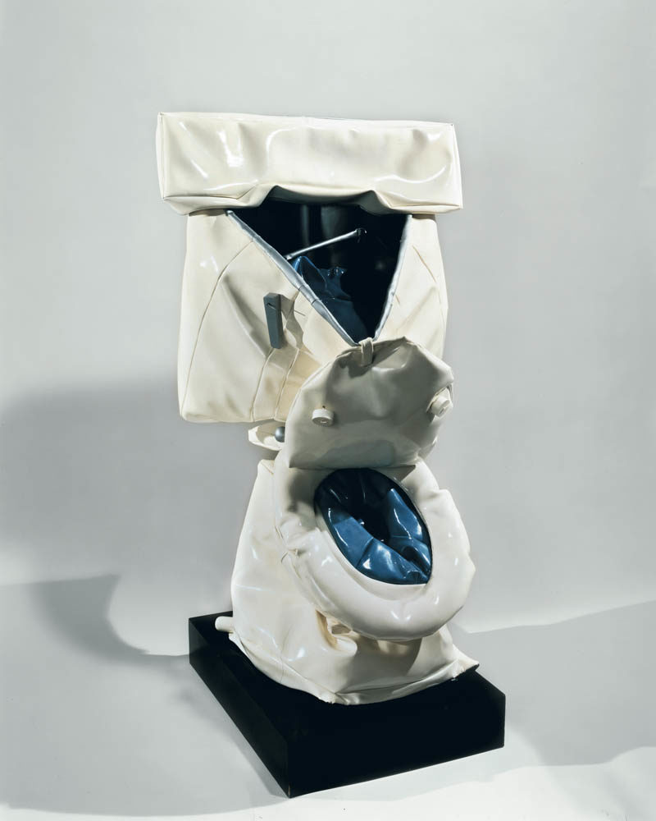
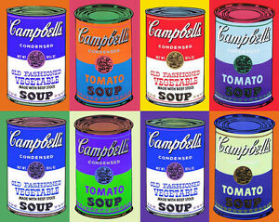
What is pop art?
Art movement that started in the 50s
Featured things from pop culture
Challenged fine art

Slide 3
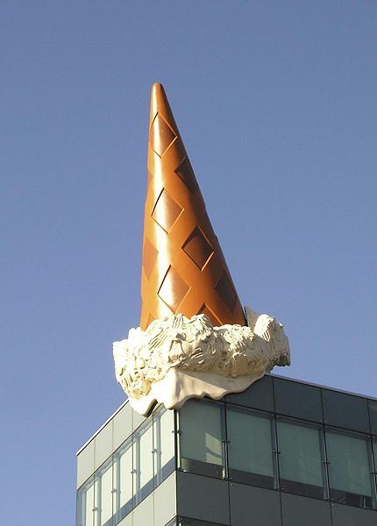
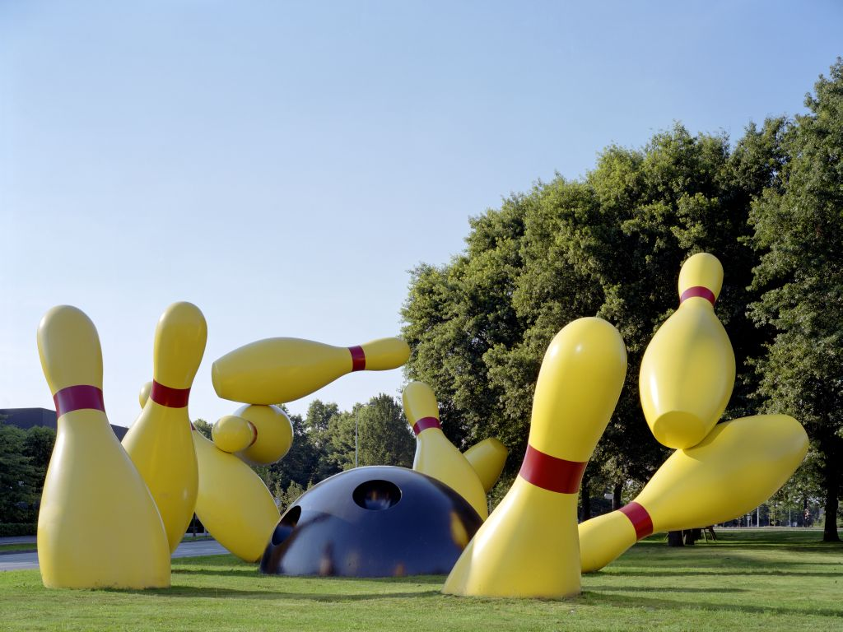
His Public installations

Slide 4
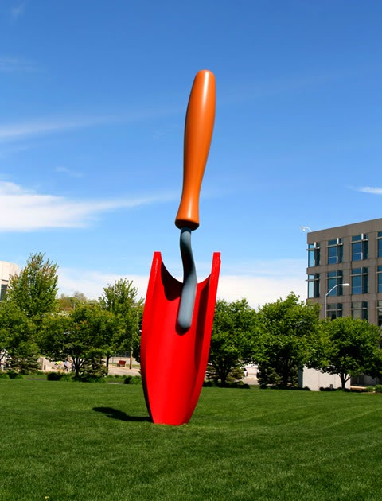
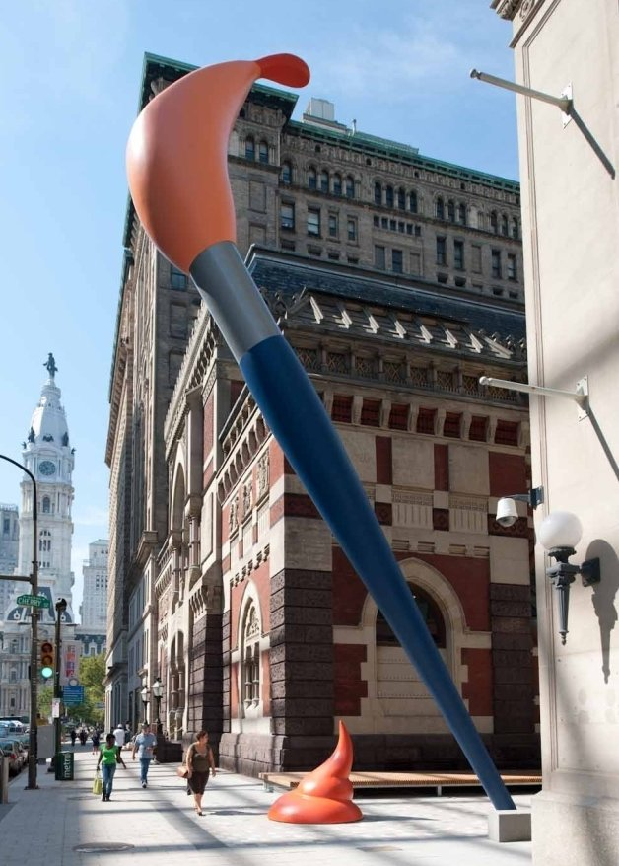

Slide 5
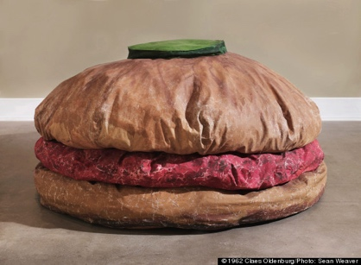
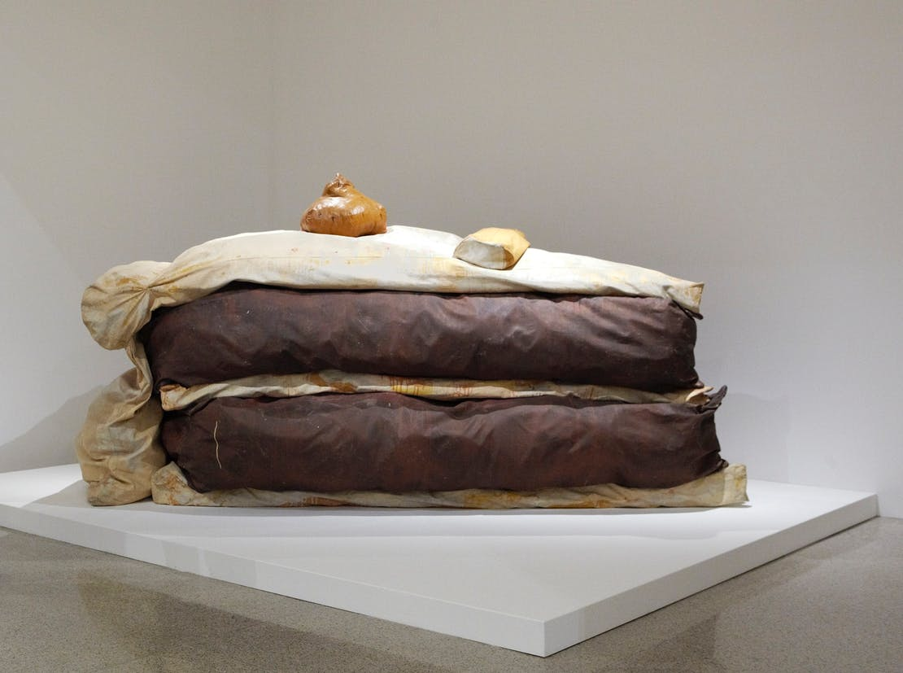
His Soft sculptures

Slide 6
