Slide 1
Photogrammetry
Jacky Yutani
Haley Shannon
Sarah Neill

Slide 2
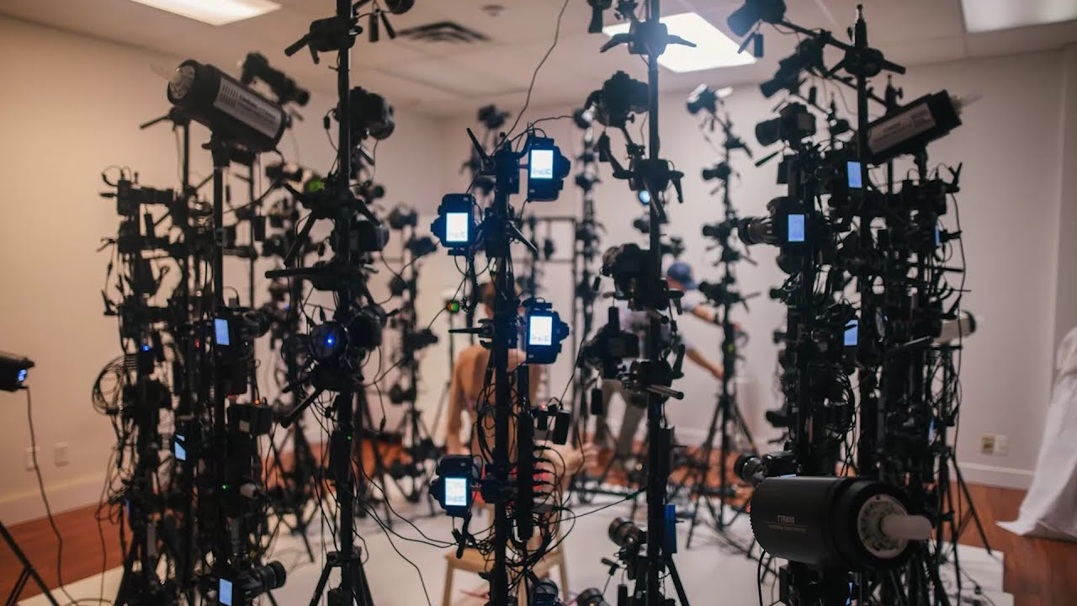
What is Photogrammetry?
Photos to 3D models
As old as photography
Notes:
Photogrammetry is the process of mathematically mapping photos to create a 3D object
The photogrammetric process dates back to the beginning of photography in the mid 1800s
Started with stereoplotters that plotted contour lines on maps

Slide 3
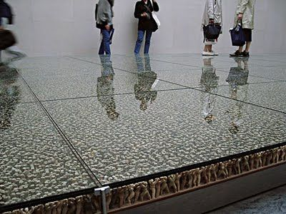
Do Ho Suh
Floor
Notes:
Contemporary artist from Korea that uses photogrammetry and 3d printing in his sculptures and installations

Slide 4
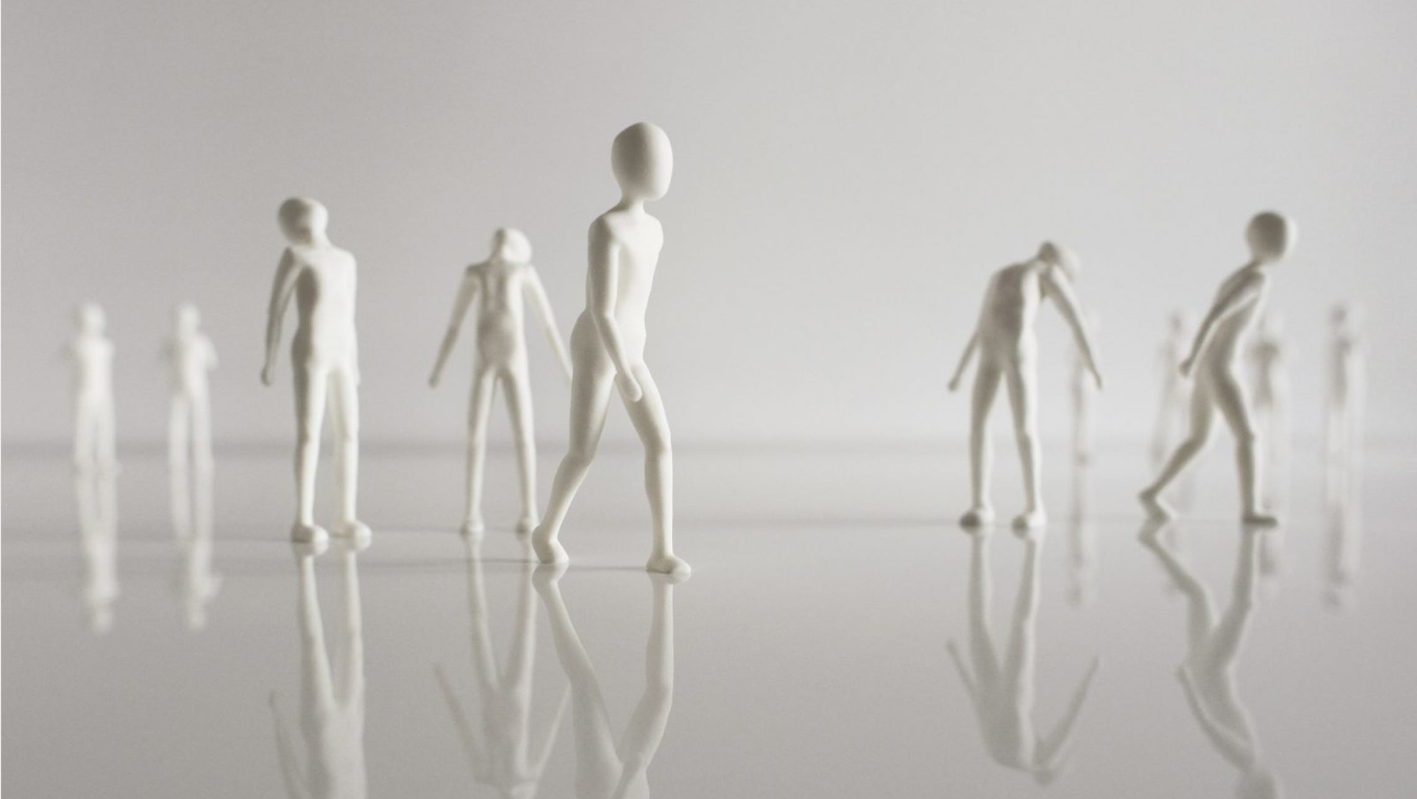
Marcy Milks
The Population
Notes:
Another contemporary artist using 3D printed figures in their art
She is from new york and is an artist, graphic designer and photographer

Slide 5
Photogrammetry Project
My Own World
Step 1: Photograph yourself
Step 2: Edit the photos in photoshop if needed
Step 3: Create model in Re Cap
Step 4: Edit model
Step 5: Print model
Step 6: Create your figure’s environment
Notes:
You’ll need between 20 and 50 photos(20 absolute minimum) in any pose
Edit the photos if needed, if the background is not consistent
Upload the photos to Autodesk ReCap to create a 3D model
Edit the model in Meshmixer
Print the object on Lulzbot printer
Create the figure’s environment physically or digitally

