Slide 1
Latin American Art
Jackelyn Yutani

Slide 2
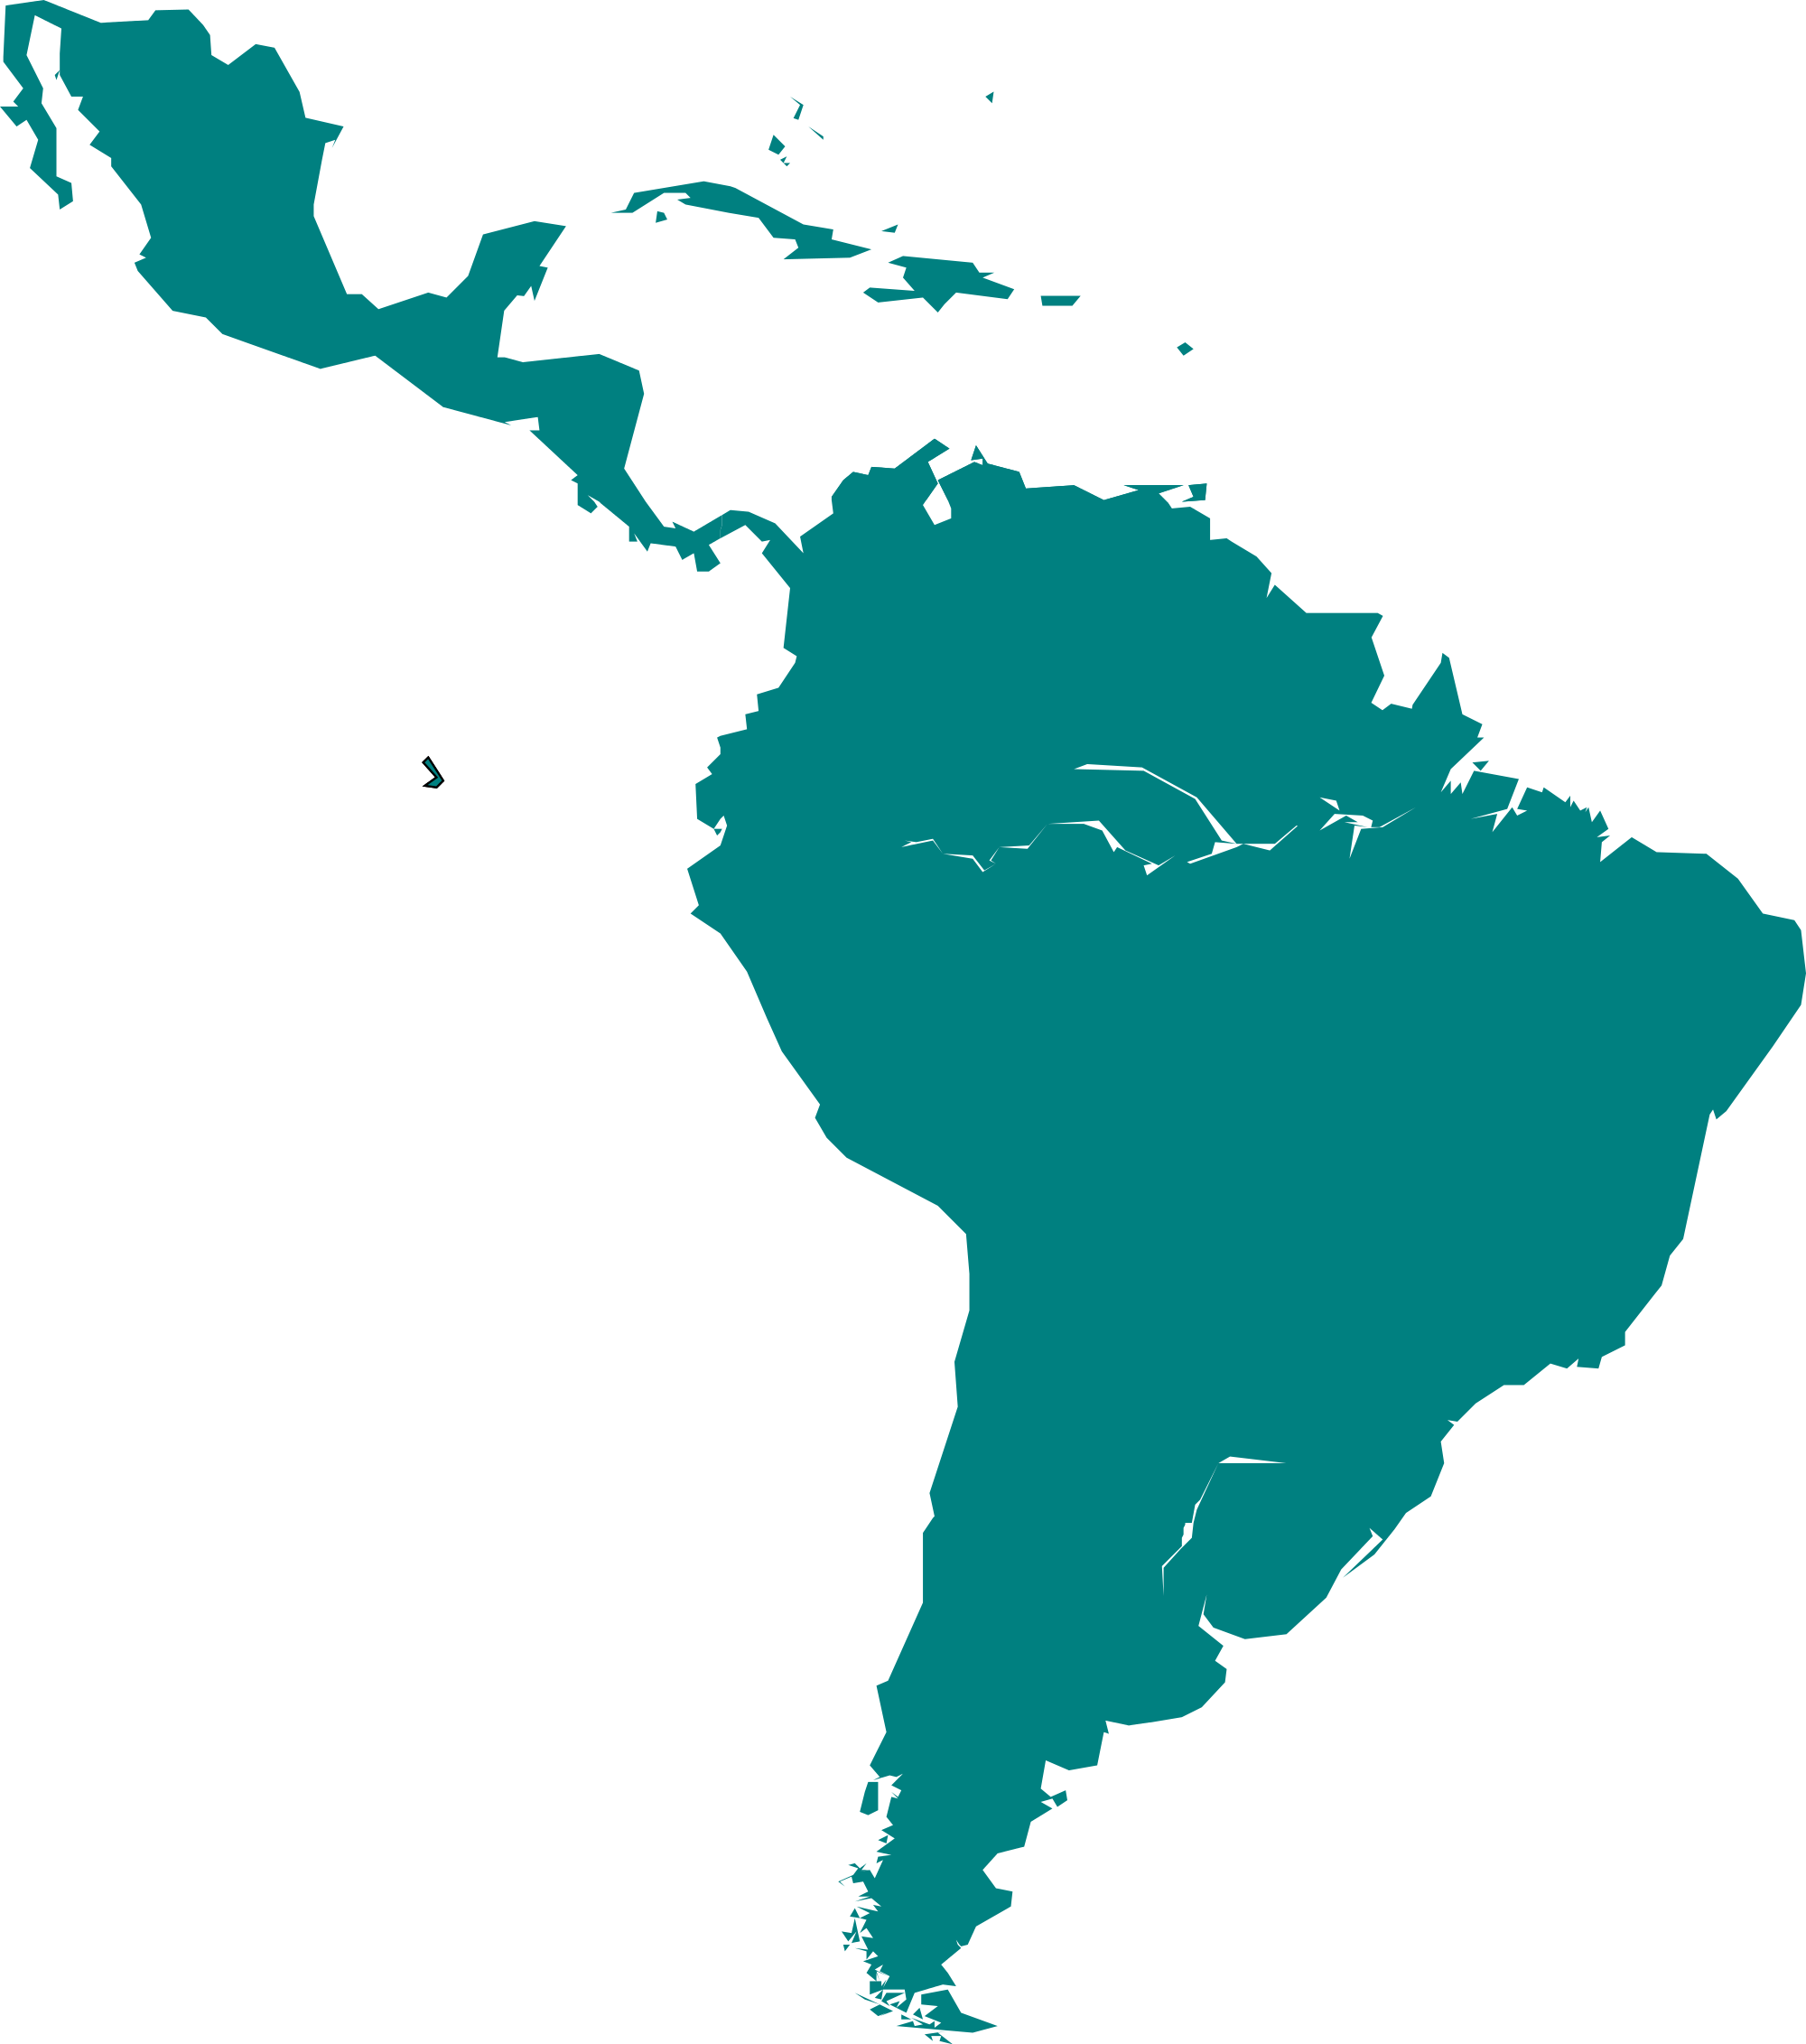
What is “Latin America”?
Notes:
There are Latin Americans, Latins, & Hispanics
Latin America- “territories colonized by Spain, Portugal, France
Hispanic- people, countries, cultures related to spain, connected by history
Latin- of a country that speaks a language derived from Latin

Slide 3
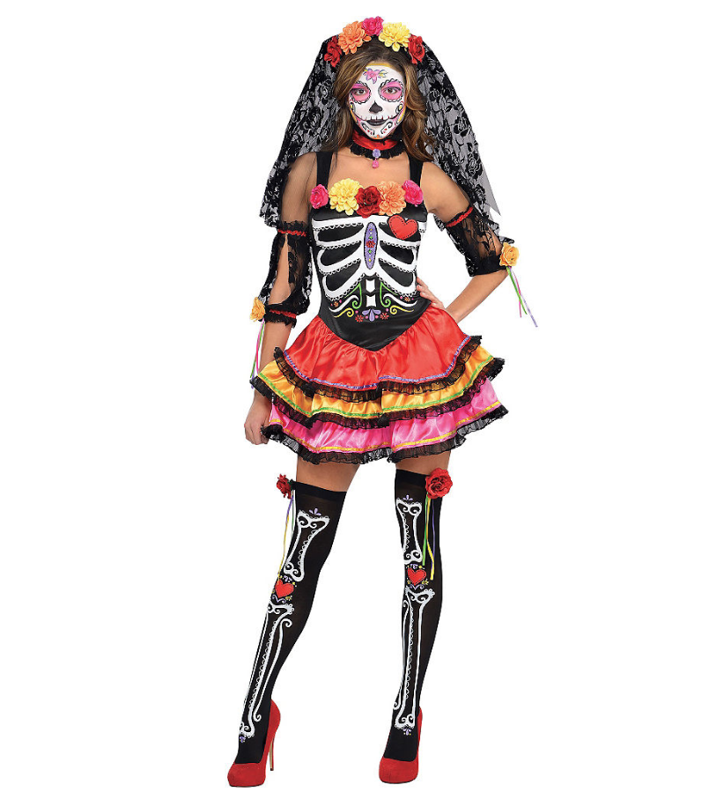
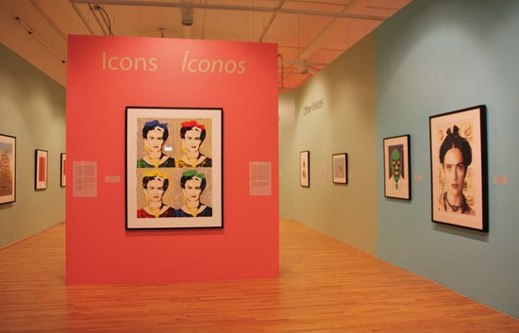
Latin American Art Reading
What did you think?
Notes:
Incite class discussion about the reading/ refresh information
Ask opinion on whether art from Latin America/ Latin American art should be labeled as such or not
Ask why/the importance

Slide 4
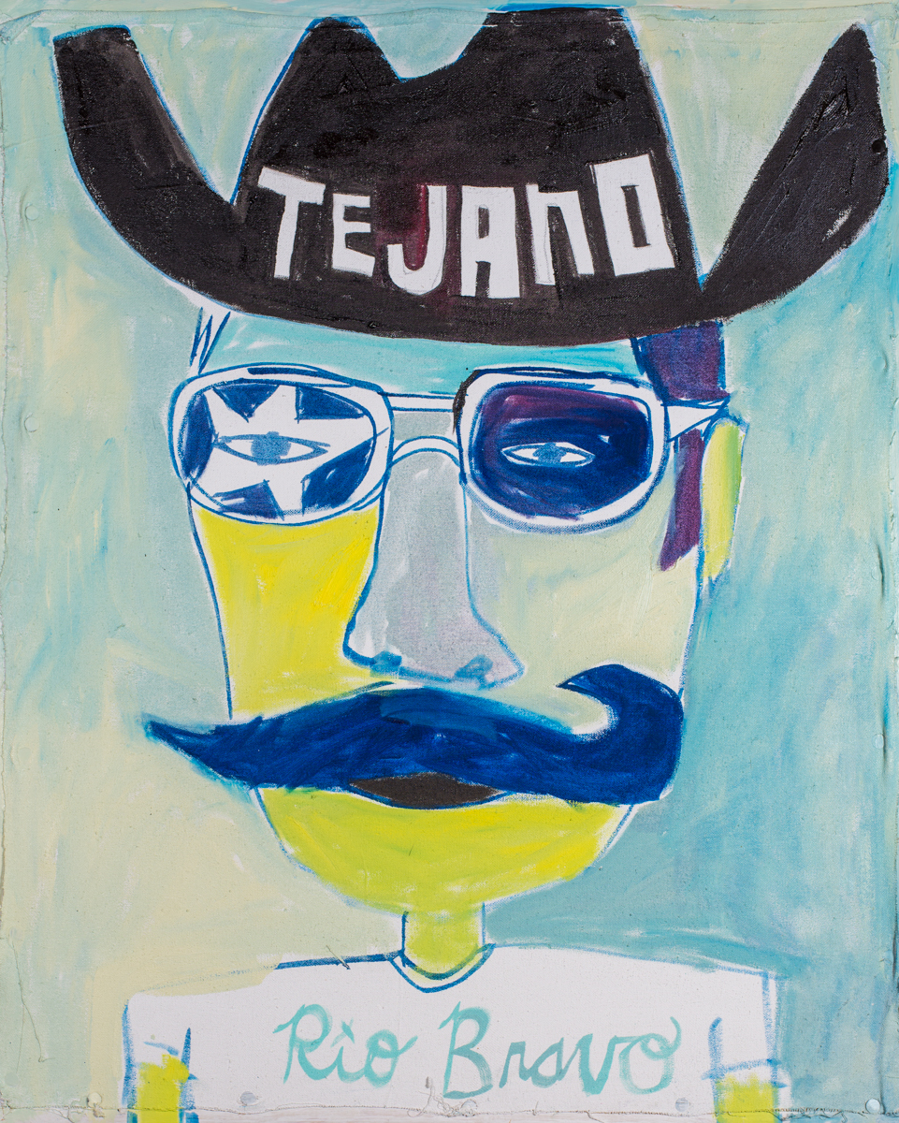
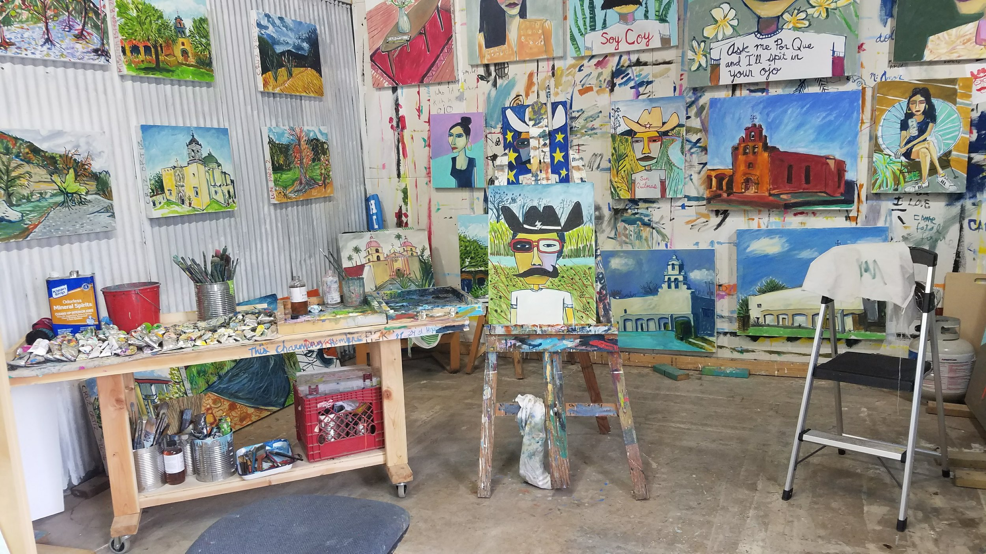
Cruz Ortiz
Notes:
Texan- Lives and works in San Antonio
Paint, print, sculpture, drawing, public activation
Focus on “Tex-Mex” Tejano culture
“Art brute” style, simplification & abstraction of form similar to Picasso

Slide 5
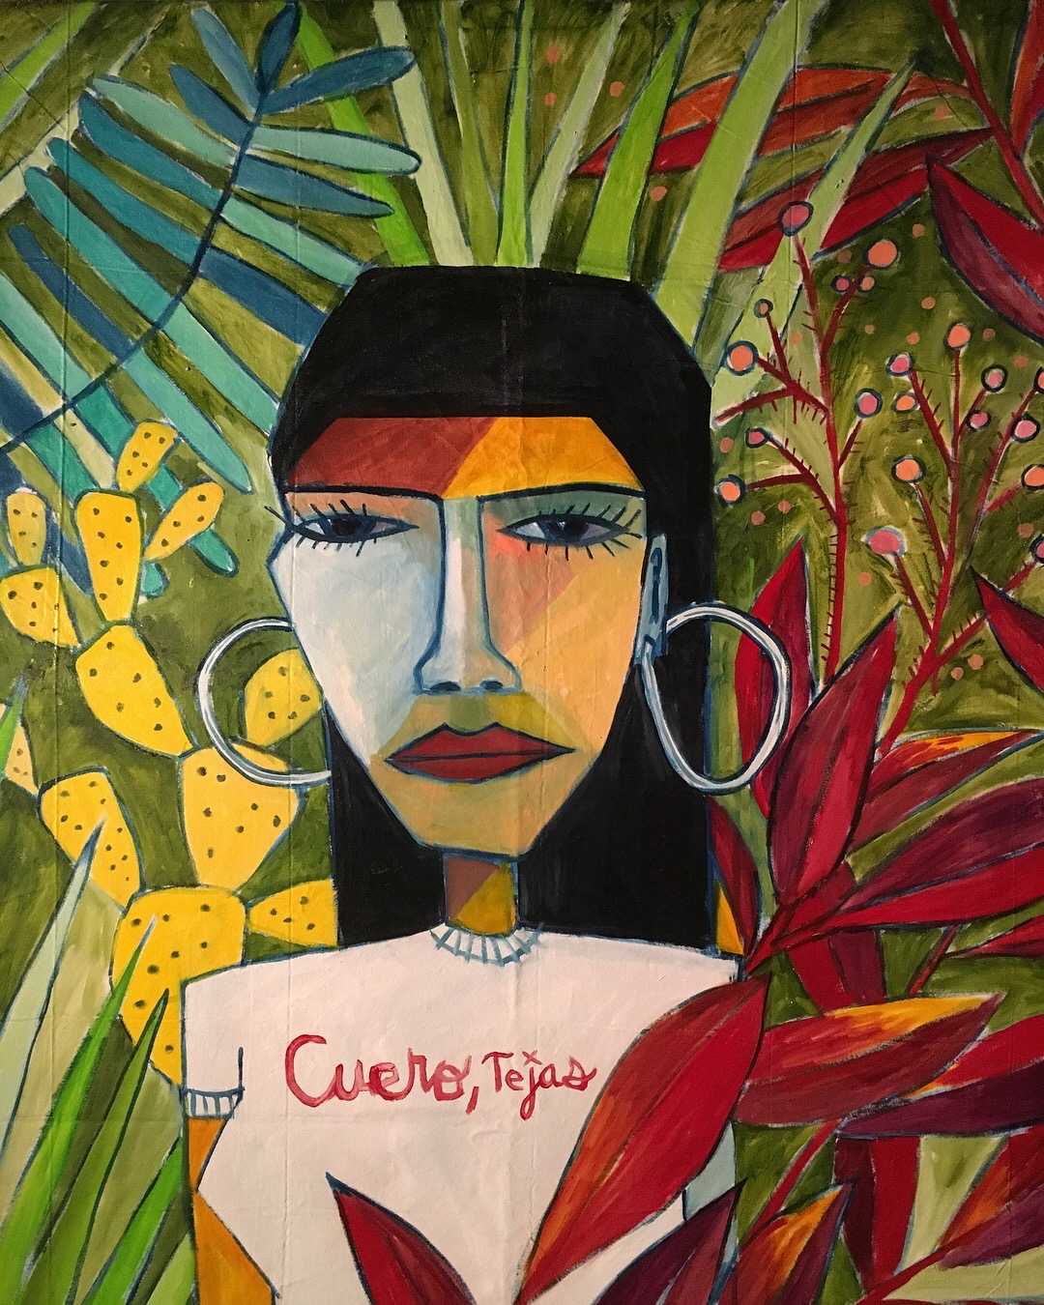
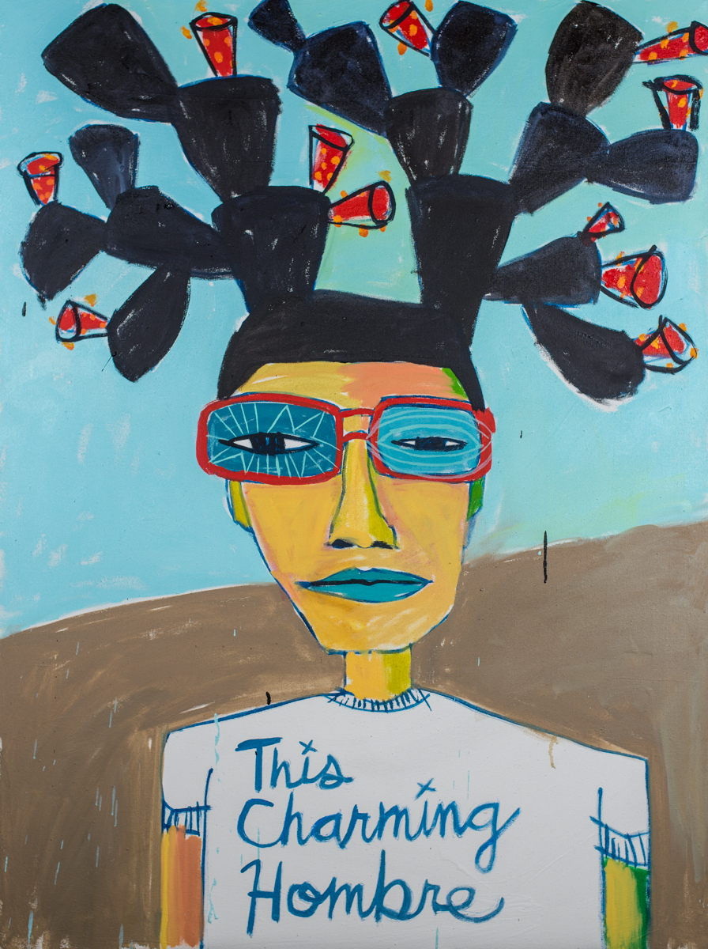
Works
Notes:
Untitled oil paintings
Flat planes of color
Angular

Slide 6
Lesson
“Cruz Ortiz Style” Texas project
Notes:
Middle school lesson= TX history
painting in style of cruz ortiz
Does not have to be self portrait
Identity/culture within Texas

