Slide 1
MonoPrint Diptych lesson: High school Art i
Jacky Yutani

Slide 2
My Burden & my ease
Enduring Idea: Self-reflection and empathy
Essential question:
What struggles could someone be going through that they may not show?

Slide 3
My Burden & My ease
Objectives
After the lesson:
Students will show understanding of their own stressors and comforts.
Students will be able to demonstrate their knowledge of monoprinting technique.
Students will be able to discuss their own work with their peers and receive feedback
Students will be able to effectively crop and mount prints that are a minimum of 6x6 inches with a 1 to 2 inch border.

Slide 4
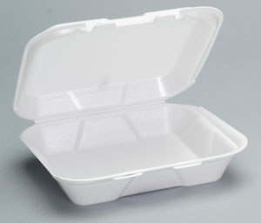
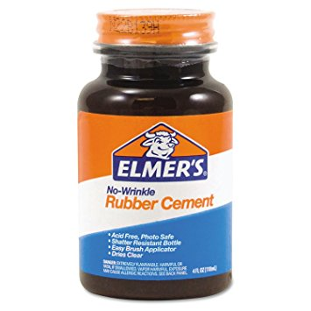
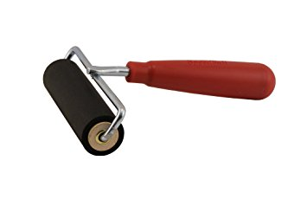
materials
Wet media of choice
Roller brushes/brayer
Styrofoam(preferably recycled)
Mixed media paper or bristol
Mounting board
Ruler
Rubber cement
Xacto knives

Slide 5
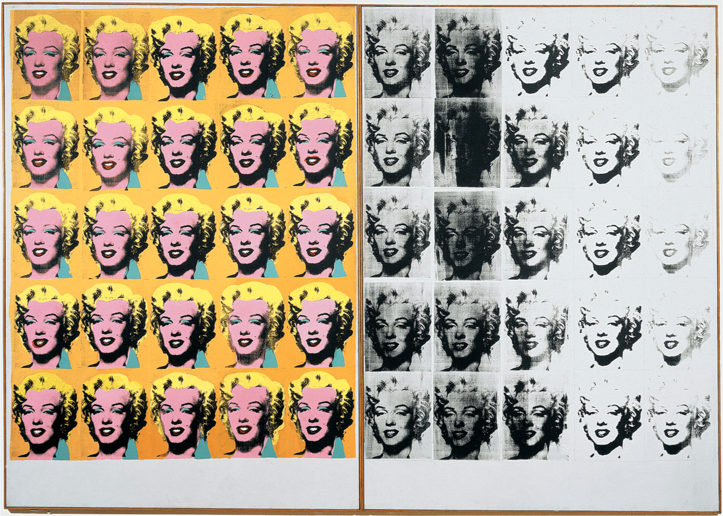
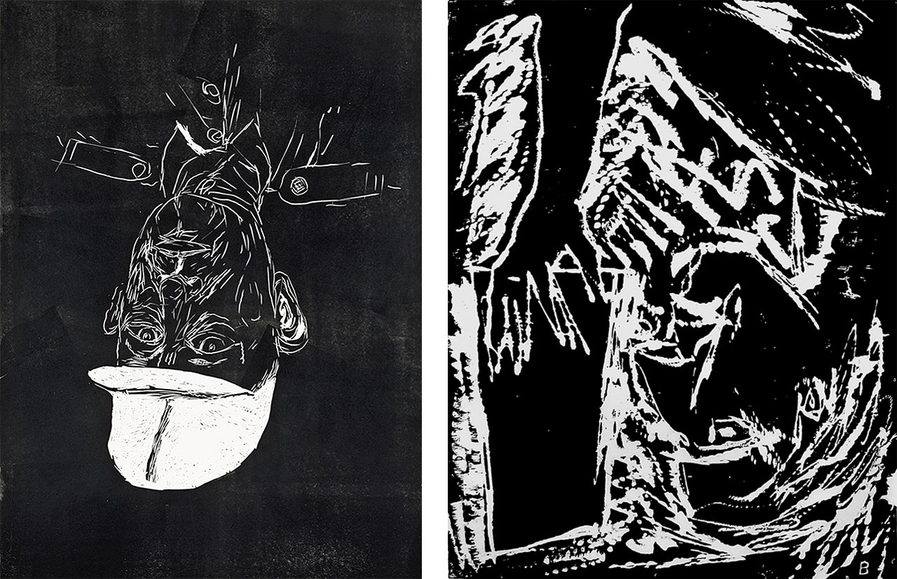
Day 1 (90 minutes)
Powerpoint to ntroduce students to monoprints and diptychs and show examples(15 min)
Give demo on creating additive and subtractive prints
Use rest of class for brainstorming a fear/burden and comfort/ease
Instruct students to bring styrofoam for next class(clean and preferably pre-used) and mounting board
Andy Warhol
Georg Baselitz

Slide 6
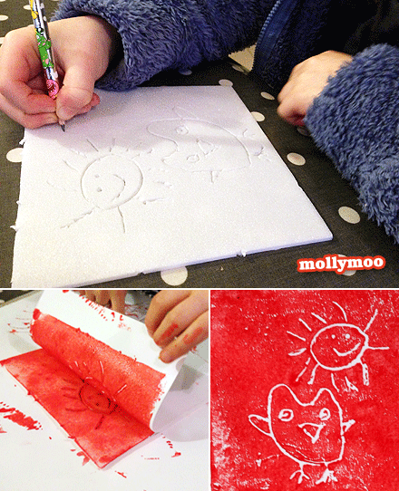
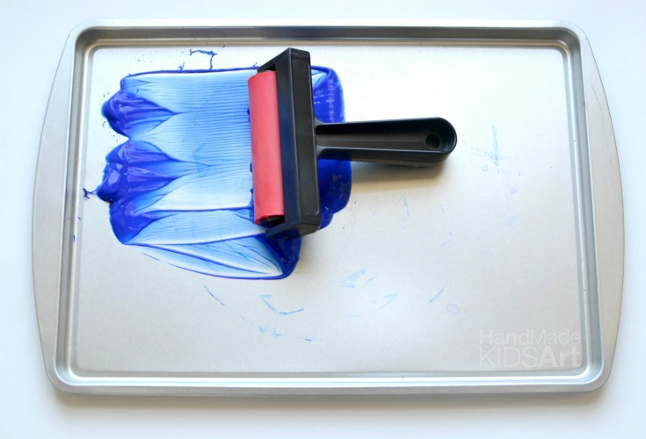
Day 2
Quick repeat of demo
Allow first half of class for continued brainstorming
By second half of class students will begin etching into styrofoam or painting on its surface

Slide 7
Day 3
Cropping and mounting demo
Students will continue to work on prints
If a student finishes, they may begin cropping

Slide 8
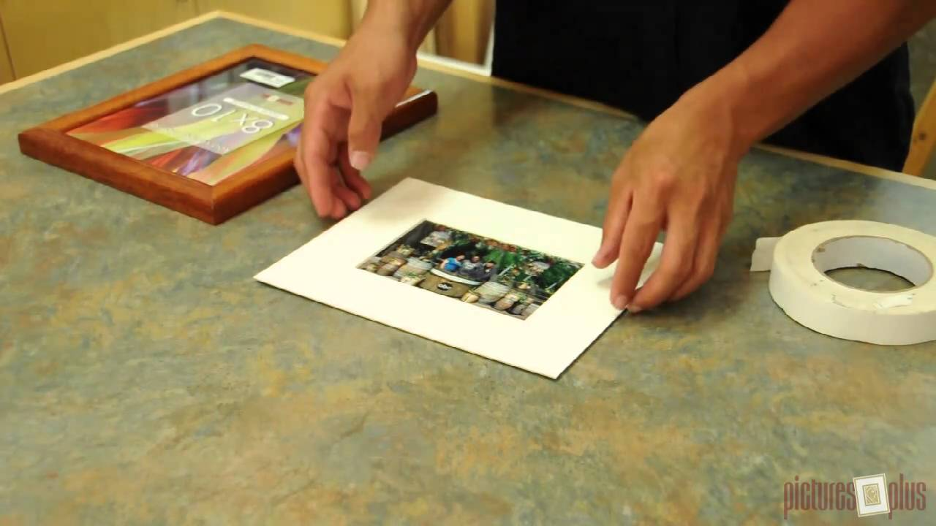
Day 4
Students will be cropping and mounting their pieces
I will go over how critique next class will be conducted and the proper vocabulary to use(i.e. paying attention to use of elements of art and principles of design, giving helpful feedback, saying more than “it’s nice”)

Slide 9
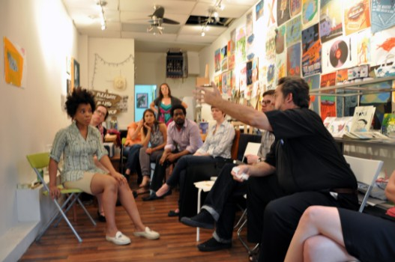
Day 5(6)
Students will each set up their work in the designated critique space and talk about it with the class, other students will comment after with constructive feedback(about 5 minutes)

Slide 10
Grading
60% completion of prints and effort shown by specific student
20%mounting
10% participation in critique of others (2 comments minimum per person during all of crit for full credit)
10% discussing their own piece during critique

