Slide 1
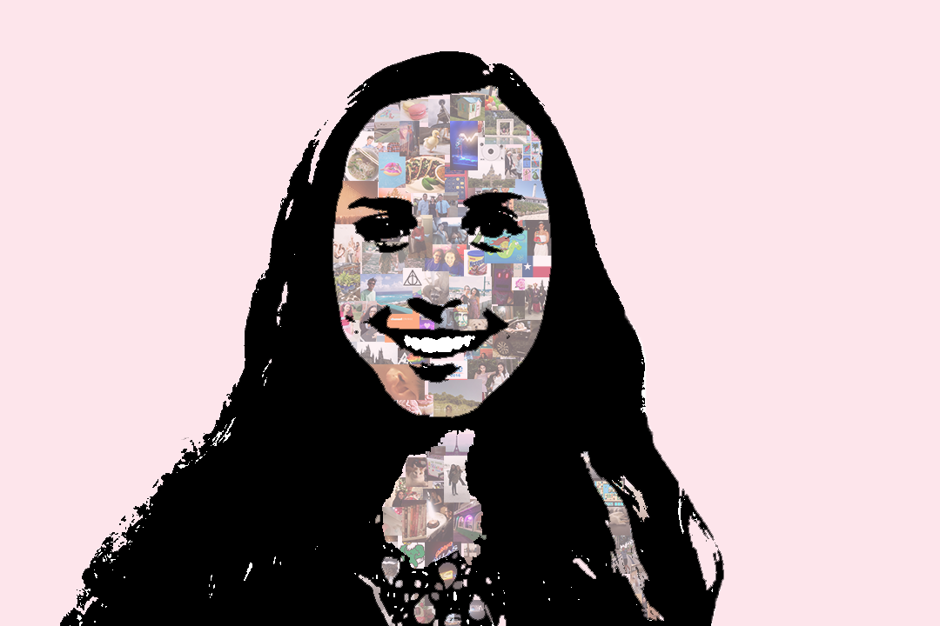
P O R T R A I T C O L L A G E
Jacky Yutani

Slide 2
Intro
What is collage?
Is collage an art form?
What are some famous collages?
Notes:
- Collage is a method that has been used for centuries but has not always been regarded as ”real art”
How can we make ours meaningful?
Collage is an artwork made by combination

Slide 3
Artists
Royal Academy of Art
Tate gallery
Joseph Cornell
Robert Rauschenberg

Slide 4
The Project
Your past, present, and future
How do our past experiences shape who we are?
Who are we now?
Notes:
Enduring Idea: My past, my present, and my future
YOU or Someone you know:
How have our past experiences shaped us?
What makes up our identity now?
What are your goals, hobbies, likes, and dislikes?
How can we capture the essense of a person from pictures?

